Slide 1
Artificial Neural Network
Il-Chul Moon Dept. of Industrial and Systems Engineering KAIST
icmoon@kaist.ac.kr

Slide 2
Weekly Objectives
Learn the perceptron and the neural network
Understand the mechanism of single perceptron
Know the structure of the single perceptron
Understand the roles of activation and pre-activation functions
Understand the limitation of the single perceptron and the need of hidden layers
Know how to infer the parameters of artificial neural network
Know the loss function of neural networks
Derive the gradients of functions in neural networks
Apply the gradient descent algorithm to infer the parameters
Understand the back-propagation algorithm to train the neural networks

Slide 3
Perceptron and Neural Network

Slide 4
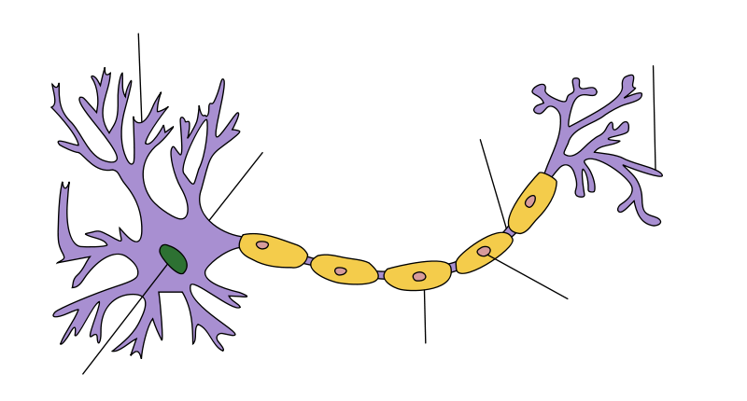
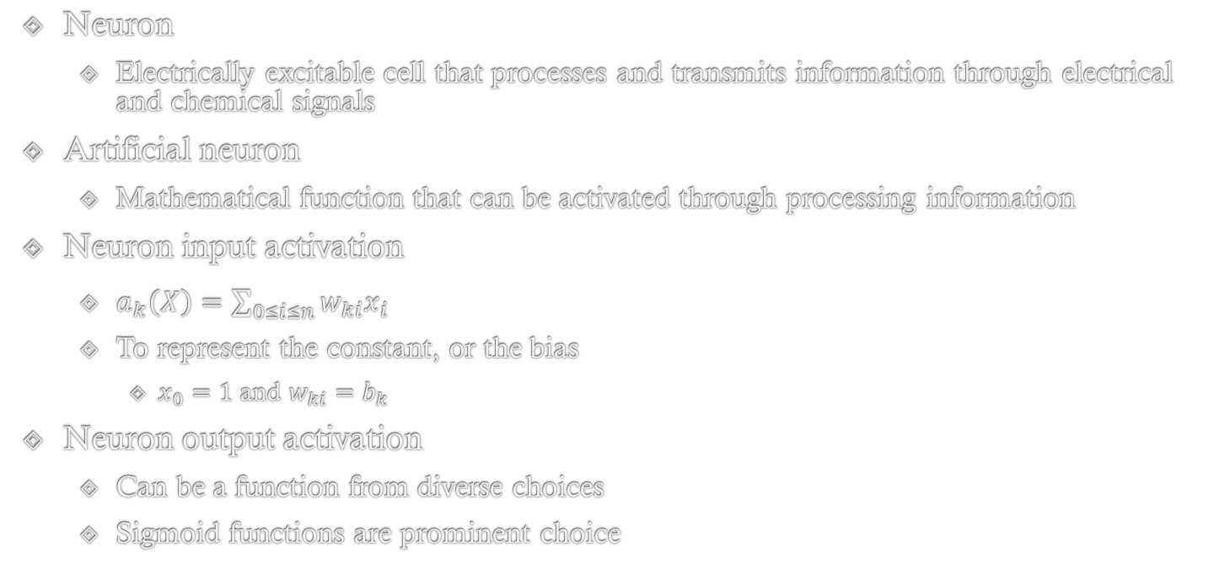
Artificial Neuron
©Wikipedia
Neuron
Electrically excitable cell that processes and transmits information through electrical and chemical signals
Artificial neuron
Mathematical function that can be activated through processing information
Neuron input activation
$a_{k}\left(X\right)=\sum_{0≤i≤n}{w_{ki}x_{i}}$
To represent the constant, or the bias
$x_{0}=1$ and $w_{ki}=b_{k}$
Neuron output activation
Can be a function from diverse choices
Sigmoid functions are prominent choice
x₀
w_{k0}
x₁
w_{k1}
g(a_{k})
…….
a_{k}
y_{k}
w_{k2}
x_{n-1}
w_{k3}
x_{n}

Slide 5
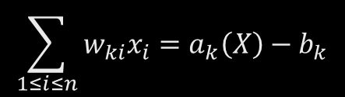
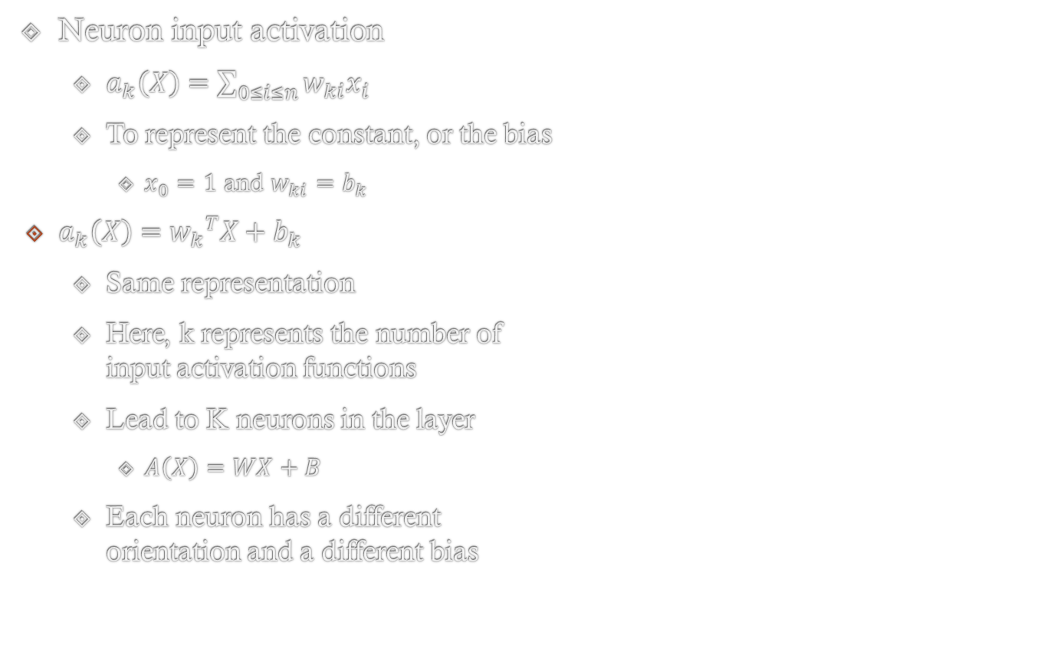
Neuron Input Activation Function
x₃
Neuron input activation
$a_{k}\left(X\right)=\sum_{0≤i≤n}{w_{ki}x_{i}}$
To represent the constant, or the bias
$x_{0}=1$ and $w_{ki}=b_{k}$
$a_{k}\left(X\right)={w_{k}}^{T}X+b_{k}$
Same representation
Here, k represents the number of input activation functions
Lead to K neurons in the layer
$A\left(X\right)=WX+B$
Each neuron has a different orientation and a different bias
w
x₂
x₁
$$\sum_{1≤i≤n}{w_{ki}x_{i}}=a_{k}\left(X\right)−b_{k}$$
Adjusting the hyperplane orientation
Adjusting the hyperplane location

Slide 6
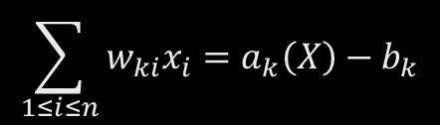
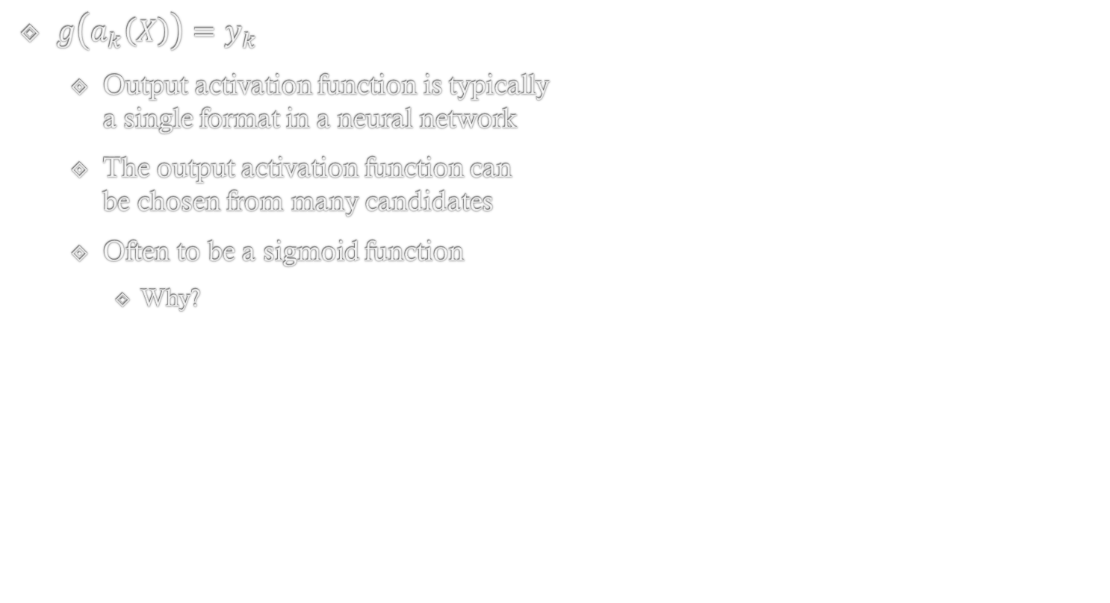
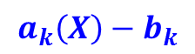
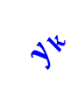
Neuron Output Activation Function
x₃
$g\left(a_{k}\left(X\right)\right)=y_{k}$
Output activation function is typically a single format in a neural network
The output activation function can be chosen from many candidates
Often to be a sigmoid function
Why?
w
x₂
$$a_{k}\left(X\right)−b_{k}$$
$$y_{k}$$
x₁
$$\sum_{1≤i≤n}{w_{ki}x_{i}}=a_{k}\left(X\right)−b_{k}$$
P(Y=y|X)
P(Y=y|X)
1
The sigmoid function shows the S-curve ranged and sharply adapted.
The output gets different by the orientation of the hyper plane
0
X
Classify as y
Classify as y

Slide 7
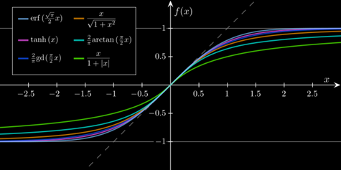
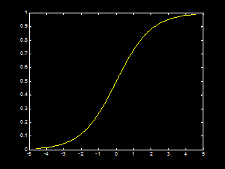
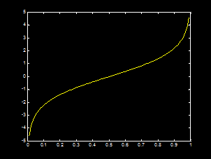
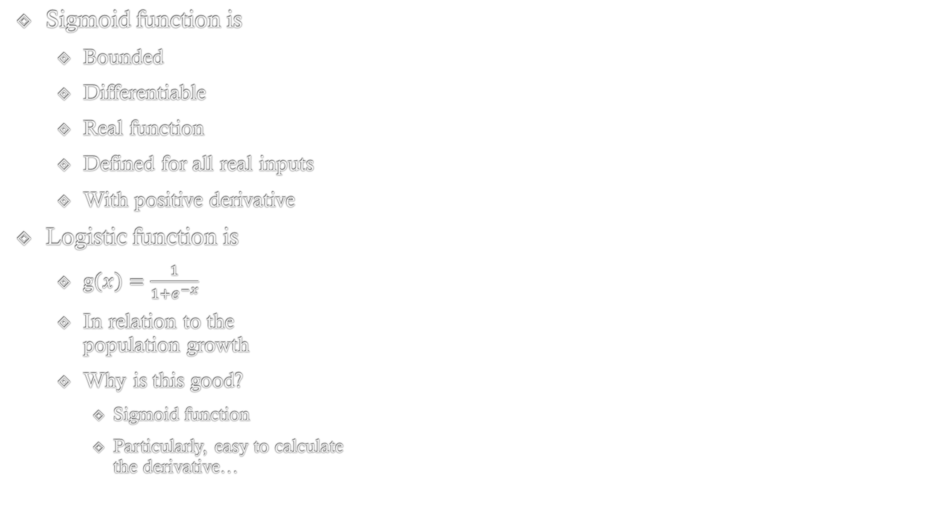
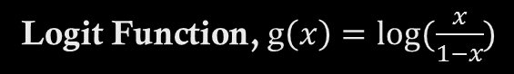
Detour: Logistic function
Neuron Output Activation Function: $g\left(a_{k}\left(X\right)\right)=y_{k}$
Many types of sigmoid functions
Sigmoid function is
Bounded
Differentiable
Real function
Defined for all real inputs
With positive derivative
Logistic function is
g$\left(x\right)=\frac{1}{1+e^{−x}}$
In relation to the population growth
Why is this good?
Sigmoid function
Particularly, easy to calculate the derivative…
©Wikipedia
Logistic Function
Logit Function, g$\left(x\right)=log⁡(\frac{x}{1−x})$

Slide 8
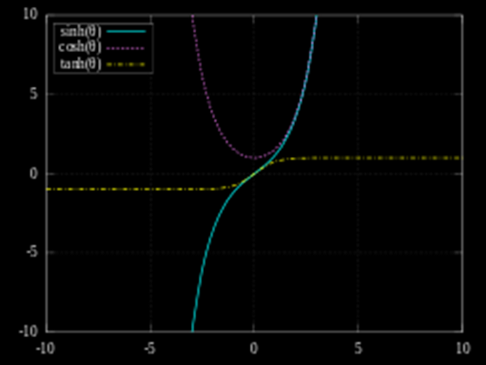
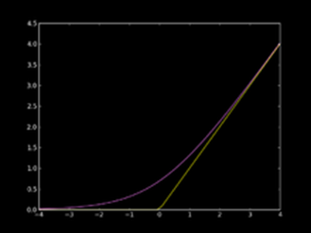
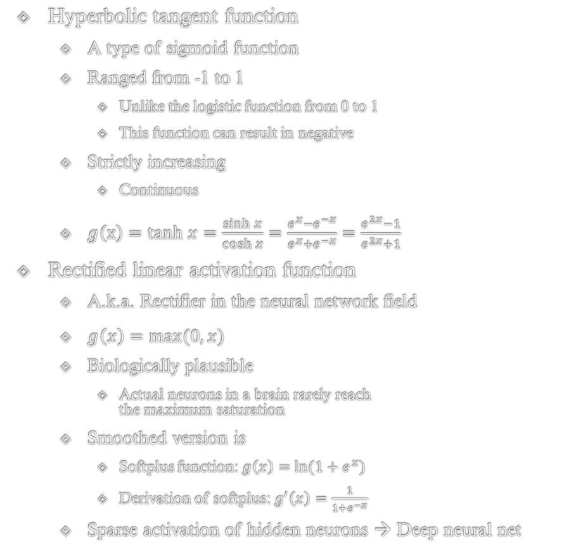
Hyperbolic Tangent Function and Rectified Linear Function
Neuron Output Activation Function: $g\left(a_{k}\left(X\right)\right)=y_{k}$
Hyperbolic tangent function
A type of sigmoid function
Ranged from -1 to 1
Unlike the logistic function from 0 to 1
This function can result in negative
Strictly increasing
Continuous
$g\left(x\right)=tanh x=\frac{\sinh{x}}{\cosh{x}}=\frac{e^{x}−e^{−x}}{e^{x}+e^{−x}}=\frac{e^{2x}−1}{e^{2x}+1}$
Rectified linear activation function
A.k.a. Rectifier in the neural network field
$g\left(x\right)=max⁡(0,x)$
Biologically plausible
Actual neurons in a brain rarely reach the maximum saturation
Smoothed version is
Softplus function: $g\left(x\right)=ln⁡(1+e^{x})$
Derivation of softplus: $g^{′}\left(x\right)=\frac{1}{1+e^{−x}}$
Sparse activation of hidden neurons → Deep neural net

Slide 9
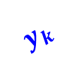
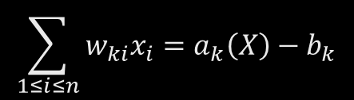
Classification with Neuron
Neuron can be used to a binary classification with a linear decision boundary
Sigmoid function
Good analogy to P(y=1|X)
E.x. Logistic regression
If a neuron output is above than the half of the range, it classifies the instance as positive
If we used the logistic function
Positive above 0.5
If we used the hyperbolic tangent function
Positive above 0
Linear decision boundary
$$y_{k}$$
x₂
w
$$\sum_{1≤i≤n}{w_{ki}x_{i}}=a_{k}\left(X\right)−b_{k}$$
x₁

Slide 10

Problem of Linear Decision Boundary
Consider the sandwich case
The orange X marks cannot be classified as the negative by the model limitation
Many real world applications have non-linear cases
Any cases with peak as positive
Then, the before and the after around the peak are negative → Non-linear boundary
Ways to make the boundary non-linear
Make the model more complex
Change the neuron input activation function
Apply the model to the higher dimension features
x₂
$$y_{k}$$
w
x₁

Slide 11
Linear Boundary and Logic Operator
Ways to make the boundary non-linear
Apply the model to the higher dimension features
XOR(x,y)
x==y→Same → Negative
x!=y→Different → Positive
Clear example of non-linear decision boundary
What if
AND(x,-y) OR AND(-x,y)
Equivalent to the linear decision boundary
x₂
XOR
1
0
0
1
x₁
AND(x₁,-x₂)
XOR
X | Y | XOR | AND (X,-Y) | AND (-X,Y) | AND(x,-y) OR AND(-x,y)
0 | 0 | 0 | 0 | 0 | 0
0 | 1 | 1 | 0 | 1 | 1
1 | 0 | 1 | 1 | 0 | 1
1 | 1 | 0 | 0 | 0 | 0
1
0
0
1
AND(-x₁,x₂)

Slide 12

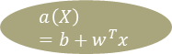
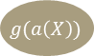

Artificial Neural Network
©Wikipedia
To overcome the linear decision boundary of a single perceptron, we use multiple perceptrons structured in a certain form.
Artificial neural network
A function approximation method with a collection of interconnected perceptrons
Structured by stacking layers
Input layer
Hidden layer
Output layer
Can create a multiple output
Input Layer
Hidden Layer
Output Layer
1
b
x₁
w₁
$$a\left(X\right)=b+w^{T}x$$
$$g(a\left(X\right))$$
$$y$$
…….
x_{n}
w_{n}

Slide 13
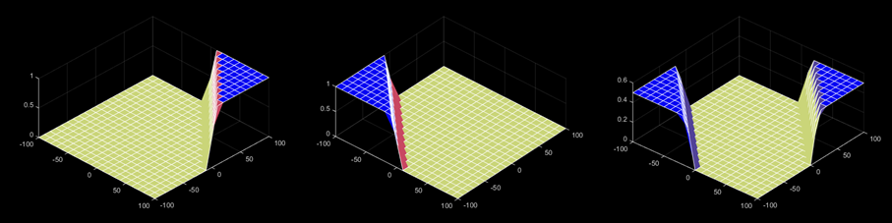
Effects of Multiple Perceptrons
Consider the following artificial neural network case
Three perceptrons
Three different sets of parameters, w
[w₁,w₂,b]
Linear pre-activation function parameters and bias
Activation function as a sigmoid function
Logistic function
Finally, we can approximate the nonlinear decision boundary
[0.5,0.5,-50]
[100,100,-100]
[-0.5,-0.5,50]

Slide 14
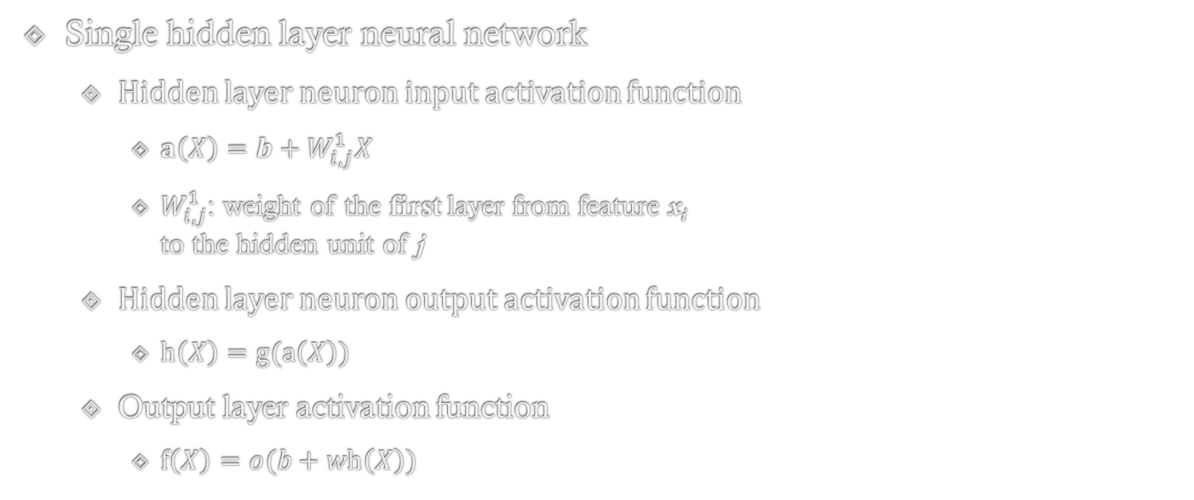
Linking Multiple Neurons
Single hidden layer neural network
Hidden layer neuron input activation function
$a\left(X\right)=b+W_{i,j}^{1}X$
$W_{i,j}^{1}$: weight of the first layer from feature x_{i} to the hidden unit of j
Hidden layer neuron output activation function
$h\left(X\right)=g(a\left(X\right))$
Output layer activation function
$f\left(X\right)=o(b+wh\left(X\right))$
x₀
w_{k0}
x₁
w_{k1}
g(a_{k})
…….
a_{k}
y_{k}
X₁
X₂
X₃
w_{k2}
x_{n-1}
w_{k3}
x_{n}

Slide 15
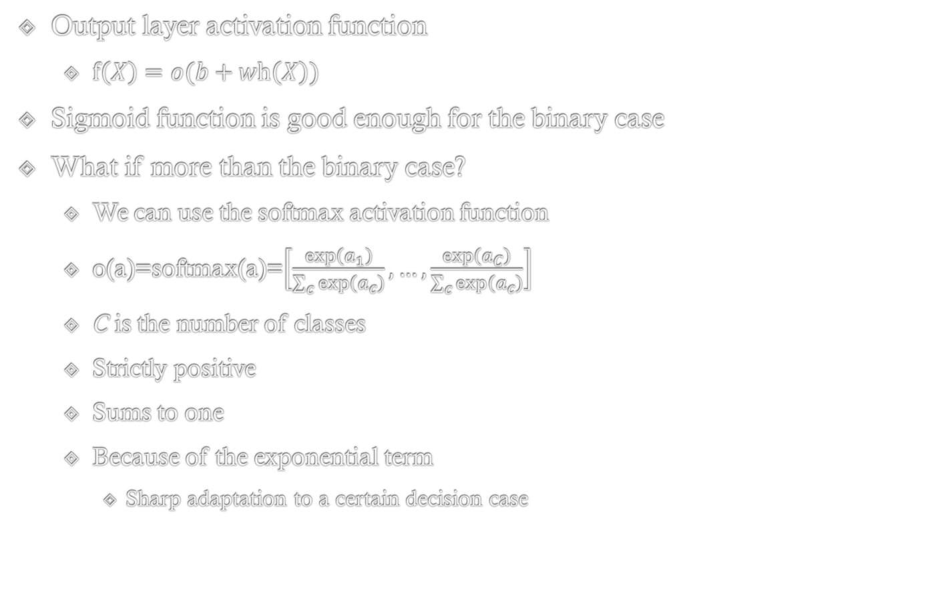
Output Activation Function
Output layer activation function
$f\left(X\right)=o(b+wh\left(X\right))$
Sigmoid function is good enough for the binary case
What if more than the binary case?
We can use the softmax activation function
o(a)=softmax(a)=$\left[\frac{\exp\left(a_{1}\right)}{\sum_{c}{\exp\left(a_{c}\right)}},…,\frac{\exp\left(a_{C}\right)}{\sum_{c}{\exp\left(a_{c}\right)}}\right]$
C is the number of classes
Strictly positive
Sums to one
Because of the exponential term
Sharp adaptation to a certain decision case

Slide 16
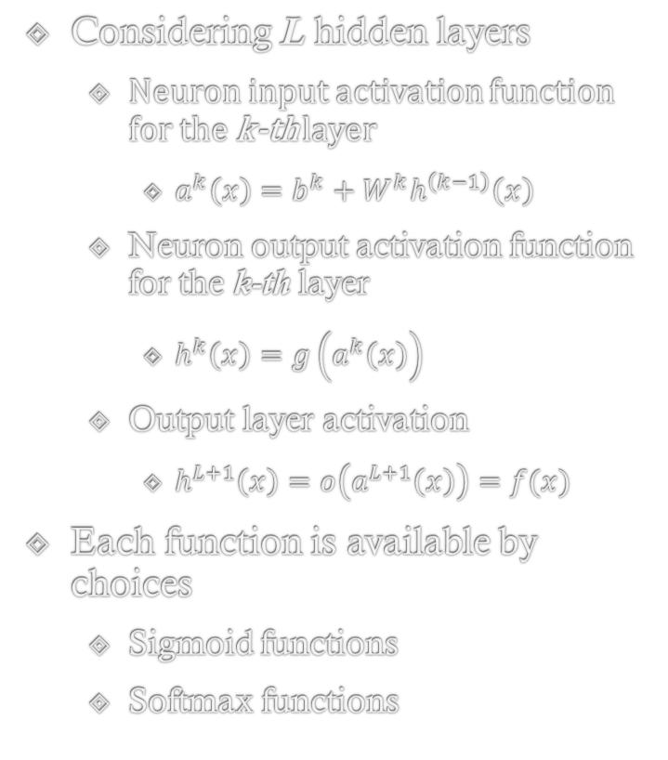
Multiple Layers of Neural Network
Considering L hidden layers
Neuron input activation function for the k-th layer
$a^{k}\left(x\right)=b^{k}+W^{k}h^{\left(k−1\right)}\left(x\right)$
Neuron output activation function for the k-th layer
$h^{k}\left(x\right)=g\left(a^{k}\left(x\right)\right)$
Output layer activation
$h^{L+1}\left(x\right)=o\left(a^{L+1}\left(x\right)\right)=f(x)$
Each function is available by choices
Sigmoid functions
Softmax functions
X₁
X₂
X₃

Slide 17
Training neural network

Slide 18
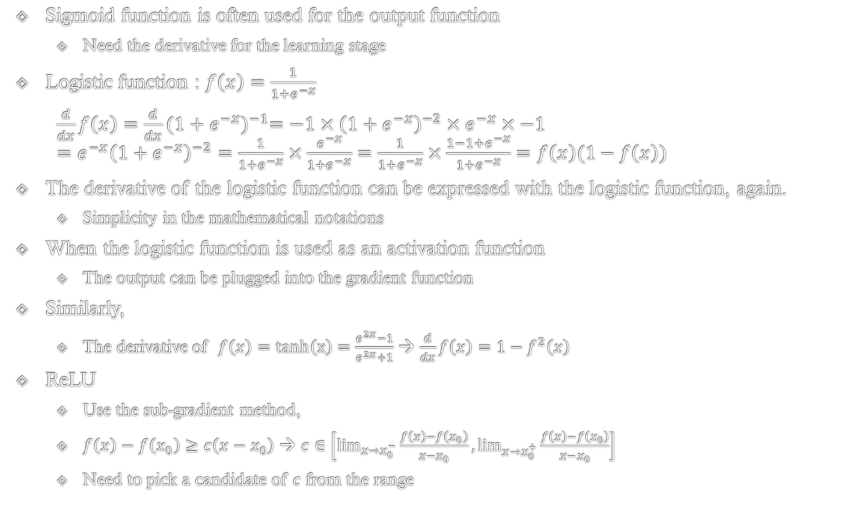
Derivative of Activation Function
Sigmoid function is often used for the output function
Need the derivative for the learning stage
Logistic function : $f\left(x\right)=\frac{1}{1+e^{−x}}$
$\frac{d}{dx}f\left(x\right)=\frac{d}{dx}{(1+e^{−x})}^{−1}=−1×{\left(1+e^{−x}\right)}^{−2}×e^{−x}×−1$ $=e^{−x}{\left(1+e^{−x}\right)}^{−2}=\frac{1}{1+e^{−x}}×\frac{e^{−x}}{1+e^{−x}}=\frac{1}{1+e^{−x}}×\frac{1−1+e^{−x}}{1+e^{−x}}=f\left(x\right)(1−f\left(x\right))$
The derivative of the logistic function can be expressed with the logistic function, again.
Simplicity in the mathematical notations
When the logistic function is used as an activation function
The output can be plugged into the gradient function
Similarly,
The derivative of $f\left(x\right)=tanh\left(x\right)=\frac{e^{2x}−1}{e^{2x}+1}$ → $\frac{d}{dx}f\left(x\right)=1−f^{2}\left(x\right)$
ReLU
Use the sub-gradient method,
$f\left(x\right)−f\left(x_{0}\right)≥c\left(x−x_{0}\right)$ → $c∈\left[\lim_{x→x_{0}^{−}}\frac{f\left(x\right)−f\left(x_{0}\right)}{x−x_{0}},\lim_{x→x_{0}^{+}}\frac{f\left(x\right)−f\left(x_{0}\right)}{x−x_{0}}\right]$
Need to pick a candidate of $c$ from the range

Slide 19






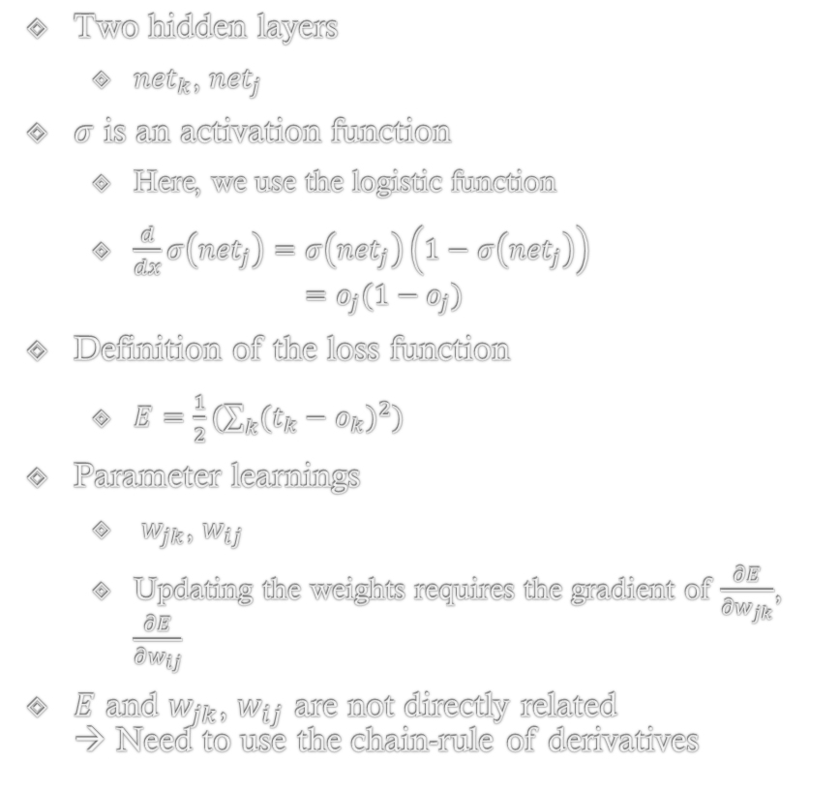




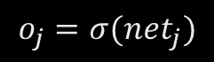



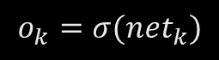
Sample Neural Network
$$o_{k}$$
…
$$o_{…}$$
…
$$o_{…}$$
$$o_{k}=σ({net}_{k})$$
Two hidden layers
${net}_{k}$, ${net}_{j}$
$σ$ is an activation function
Here, we use the logistic function
$\frac{d}{dx}σ\left({net}_{j}\right)=σ\left({net}_{j}\right)\left(1−σ\left({net}_{j}\right)\right)$ $=o_{j}(1−o_{j})$
Definition of the loss function
$E=\frac{1}{2}(\sum_{k}{{(t_{k}−o_{k})}^{2}})$
Parameter learnings
$w_{jk}$, $w_{ij}$
Updating the weights requires the gradient of $\frac{∂E}{∂w_{jk}}$, $\frac{∂E}{∂w_{ij}}$
$E$ and $w_{jk}$, $w_{ij}$ are not directly related → Need to use the chain-rule of derivatives
$${net}_{k}=\sum_{j}{w_{jk}o_{j}}$$
$$w_{jk}$$
$$o_{j}$$
…
$$o_{…}$$
…
$$o_{…}$$
$$o_{j}=σ({net}_{j})$$
$${net}_{j}=\sum_{i}{w_{ij}o_{i}}$$
$$w_{ij}$$
$$o_{i}$$
…
$$o_{…}$$
…
$$o_{…}$$

Slide 20

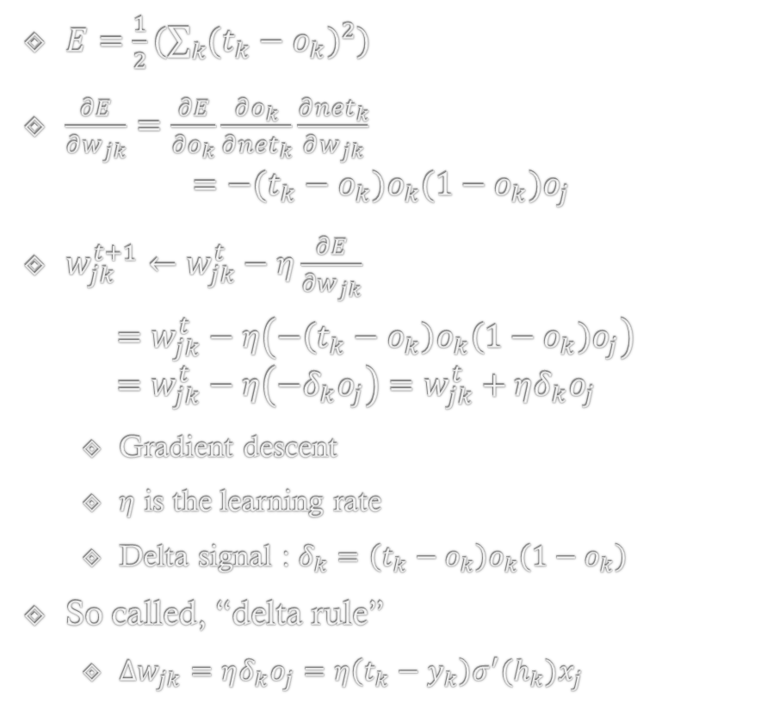
Learning Single Depth
$$\frac{d}{dx}σ\left({net}_{j}\right)=o_{j}(1−o_{j})$$
$$o_{k}$$
…
$$o_{…}$$
…
$$o_{…}$$
$$o_{k}=σ({net}_{k})$$
$E=\frac{1}{2}(\sum_{k}{{(t_{k}−o_{k})}^{2}})$
$\frac{∂E}{∂w_{jk}}=\frac{∂E}{∂o_{k}}\frac{∂o_{k}}{∂{net}_{k}}\frac{∂{net}_{k}}{∂w_{jk}}$ $=−(t_{k}−o_{k})o_{k}(1−o_{k})o_{j}$
$w_{jk}^{t+1}←w_{jk}^{t}−η\frac{∂E}{∂w_{jk}}$
$$=w_{jk}^{t}−η\left(−\left(t_{k}−o_{k}\right)o_{k}\left(1−o_{k}\right)o_{j}\right) \\ =w_{jk}^{t}−η\left(−δ_{k}o_{j}\right)=w_{jk}^{t}+ηδ_{k}o_{j}$$
Gradient descent
$η$ is the learning rate
Delta signal : $δ_{k}=\left(t_{k}−o_{k}\right)o_{k}\left(1−o_{k}\right)$
So called, “delta rule”
$Δw_{jk}=ηδ_{k}o_{j}=η\left(t_{k}−y_{k}\right)σ^{′}(h_{k})x_{j}$
$${net}_{k}=\sum_{j}{w_{jk}o_{j}}$$
$$w_{jk}$$
$$o_{j}$$
…
$$o_{…}$$
…
$$o_{…}$$
$$o_{j}=σ({net}_{j})$$
$${net}_{j}=\sum_{i}{w_{ij}o_{i}}$$
$$w_{ij}$$
$$o_{i}$$
…
$$o_{…}$$
…
$$o_{…}$$

Slide 21

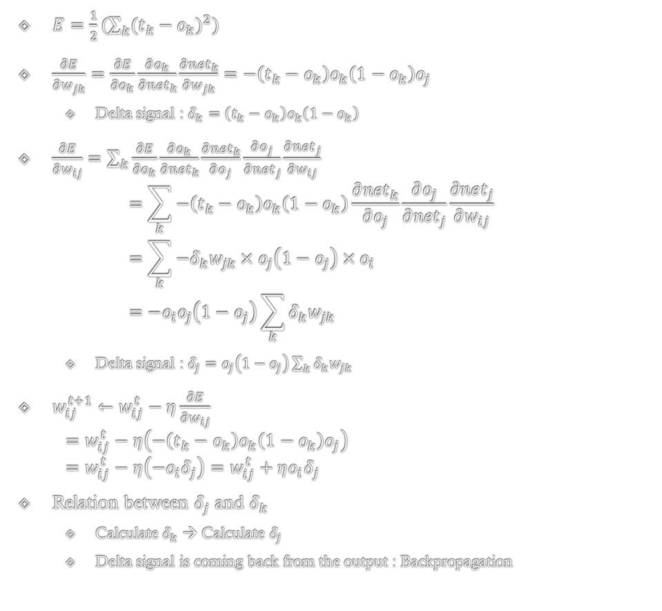
Learning Two Depth
$$\frac{d}{dx}σ\left({net}_{j}\right)=o_{j}(1−o_{j})$$
$$o_{k}$$
$$o_{…}$$
$$o_{…}$$
…
…
$E=\frac{1}{2}(\sum_{k}{{(t_{k}−o_{k})}^{2}})$
$\frac{∂E}{∂w_{jk}}=\frac{∂E}{∂o_{k}}\frac{∂o_{k}}{∂{net}_{k}}\frac{∂{net}_{k}}{∂w_{jk}}=−\left(t_{k}−o_{k}\right)o_{k}\left(1−o_{k}\right)o_{j}$
Delta signal : $δ_{k}=\left(t_{k}−o_{k}\right)o_{k}\left(1−o_{k}\right)$
$\frac{∂E}{∂w_{ij}}=\sum_{k}{\frac{∂E}{∂o_{k}}\frac{∂o_{k}}{∂{net}_{k}}\frac{∂{net}_{k}}{∂o_{j}}\frac{∂o_{j}}{∂{net}_{j}}\frac{∂{net}_{j}}{∂w_{ij}}}$ $=\sum_{k}{−\left(t_{k}−o_{k}\right)o_{k}\left(1−o_{k}\right)\frac{∂{net}_{k}}{∂o_{j}}\frac{∂o_{j}}{∂{net}_{j}}\frac{∂{net}_{j}}{∂w_{ij}}}$ $=\sum_{k}{−δ_{k}w_{jk}×o_{j}\left(1−o_{j}\right)×o_{i}}$ $=−o_{i}o_{j}\left(1−o_{j}\right)\sum_{k}{δ_{k}w_{jk}}$
Delta signal : $δ_{j}=o_{j}\left(1−o_{j}\right)\sum_{k}{δ_{k}w_{jk}}$
$w_{ij}^{t+1}←w_{ij}^{t}−η\frac{∂E}{∂w_{ij}}$ $=w_{ij}^{t}−η\left(−\left(t_{k}−o_{k}\right)o_{k}\left(1−o_{k}\right)o_{j}\right)$ $=w_{ij}^{t}−η\left(−o_{i}δ_{j}\right)=w_{ij}^{t}+ηo_{i}δ_{j}$
Relation between $δ_{j}$ and $δ_{k}$
Calculate $δ_{k}$ → Calculate $δ_{j}$
Delta signal is coming back from the output : Backpropagation
$$o_{k}=σ({net}_{k})$$
$${net}_{k}=\sum_{j}{w_{jk}o_{j}}$$
$$w_{jk}$$
$$o_{j}$$
…
$$o_{…}$$
…
$$o_{…}$$
$$o_{j}=σ({net}_{j})$$
$${net}_{j}=\sum_{i}{w_{ij}o_{i}}$$
$$w_{ij}$$
$$o_{i}$$
…
$$o_{…}$$
…
$$o_{…}$$

Slide 22
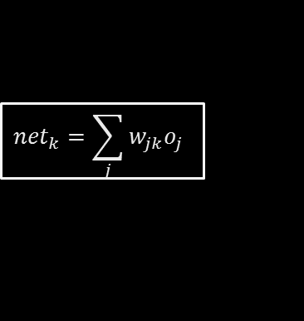




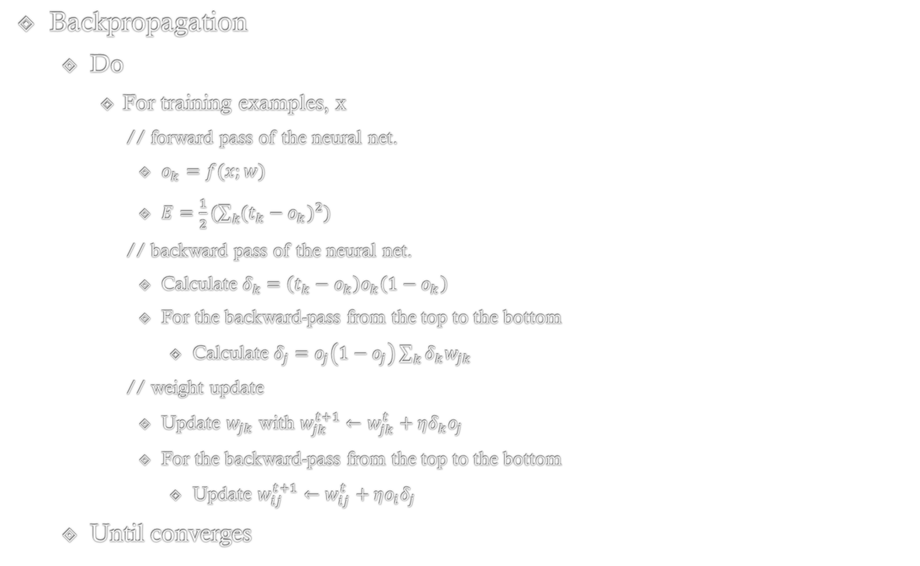
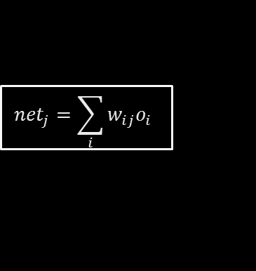
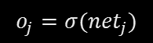

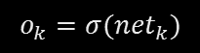


Backpropagation
$$o_{k}$$
…
$$o_{…}$$
…
$$o_{…}$$
$$o_{k}=σ({net}_{k})$$
$${net}_{k}=\sum_{j}{w_{jk}o_{j}}$$
Backpropagation
Do
For training examples, x
// forward pass of the neural net.
$o_{k}=f(x;w)$
$E=\frac{1}{2}(\sum_{k}{{(t_{k}−o_{k})}^{2}})$
// backward pass of the neural net.
Calculate $δ_{k}=\left(t_{k}−o_{k}\right)o_{k}\left(1−o_{k}\right)$
For the backward-pass from the top to the bottom
Calculate $δ_{j}=o_{j}\left(1−o_{j}\right)\sum_{k}{δ_{k}w_{jk}}$
// weight update
Update $w_{jk}$ with $w_{jk}^{t+1}←w_{jk}^{t}+ηδ_{k}o_{j}$
For the backward-pass from the top to the bottom
Update $w_{ij}^{t+1}←w_{ij}^{t}+ηo_{i}δ_{j}$
Until converges
$$w_{jk}$$
$$o_{j}$$
…
$$o_{…}$$
…
$$o_{…}$$
$$o_{j}=σ({net}_{j})$$
$${net}_{j}=\sum_{i}{w_{ij}o_{i}}$$
$$w_{ij}$$
$$o_{i}$$
…
$$o_{…}$$
…
$$o_{…}$$

Slide 23
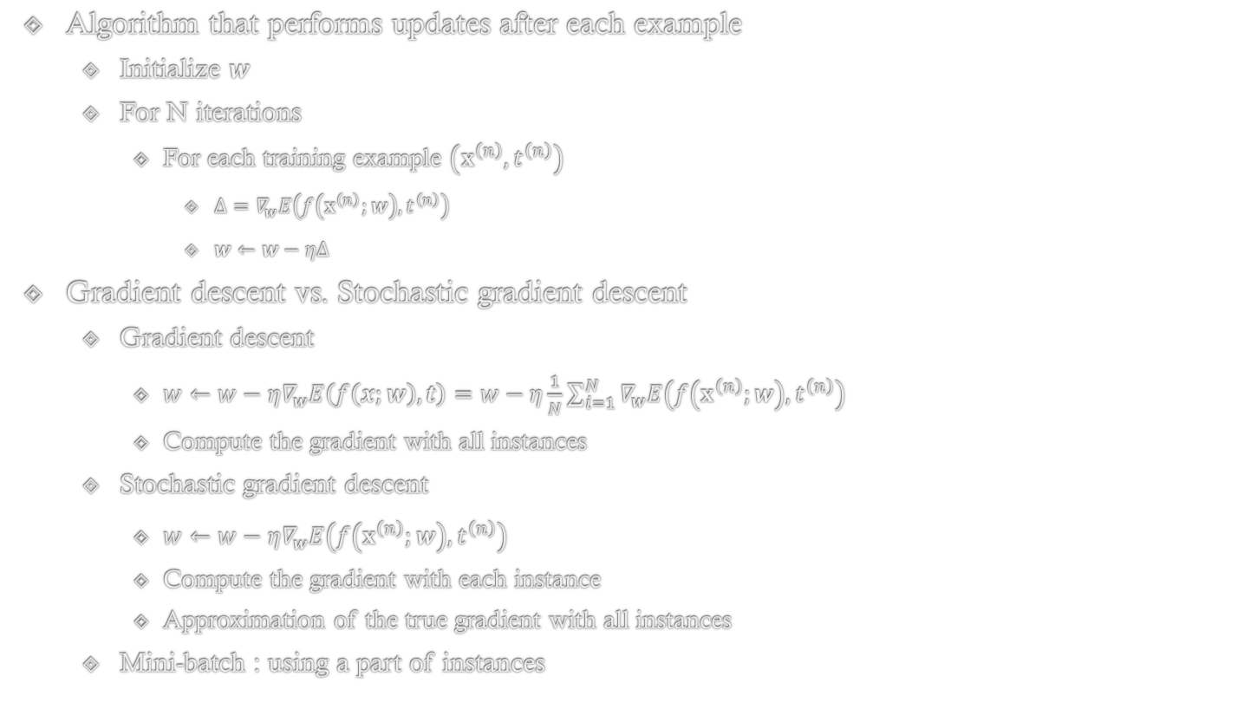
Stochastic Gradient Descent
Algorithm that performs updates after each example
Initialize $w$
For N iterations
For each training example $\left(x^{\left(n\right)},t^{\left(n\right)}\right)$
$Δ=∇_{w}E\left(f\left(x^{\left(n\right)};w\right),t^{\left(n\right)}\right)$
$w←w−ηΔ$
Gradient descent vs. Stochastic gradient descent
Gradient descent
$w←w−η∇_{w}E\left(f\left(x;w\right),t\right)=w−η\frac{1}{N}\sum_{i=1}^{N}{∇_{w}E\left(f\left(x^{\left(n\right)};w\right),t^{\left(n\right)}\right)}$
Compute the gradient with all instances
Stochastic gradient descent
$w←w−η∇_{w}E\left(f\left(x^{\left(n\right)};w\right),t^{\left(n\right)}\right)$
Compute the gradient with each instance
Approximation of the true gradient with all instances
Mini-batch : using a part of instances
Notes:
Theta를 업데이트할 때마다 overfitting되는 theta가 outputing되는 것을 방지하기 위함.
배치 이터레이션이면 배치 업데이트시 regularization term이 포함될 것.
학습 데이터에 대한 오차를 최소화

Slide 24
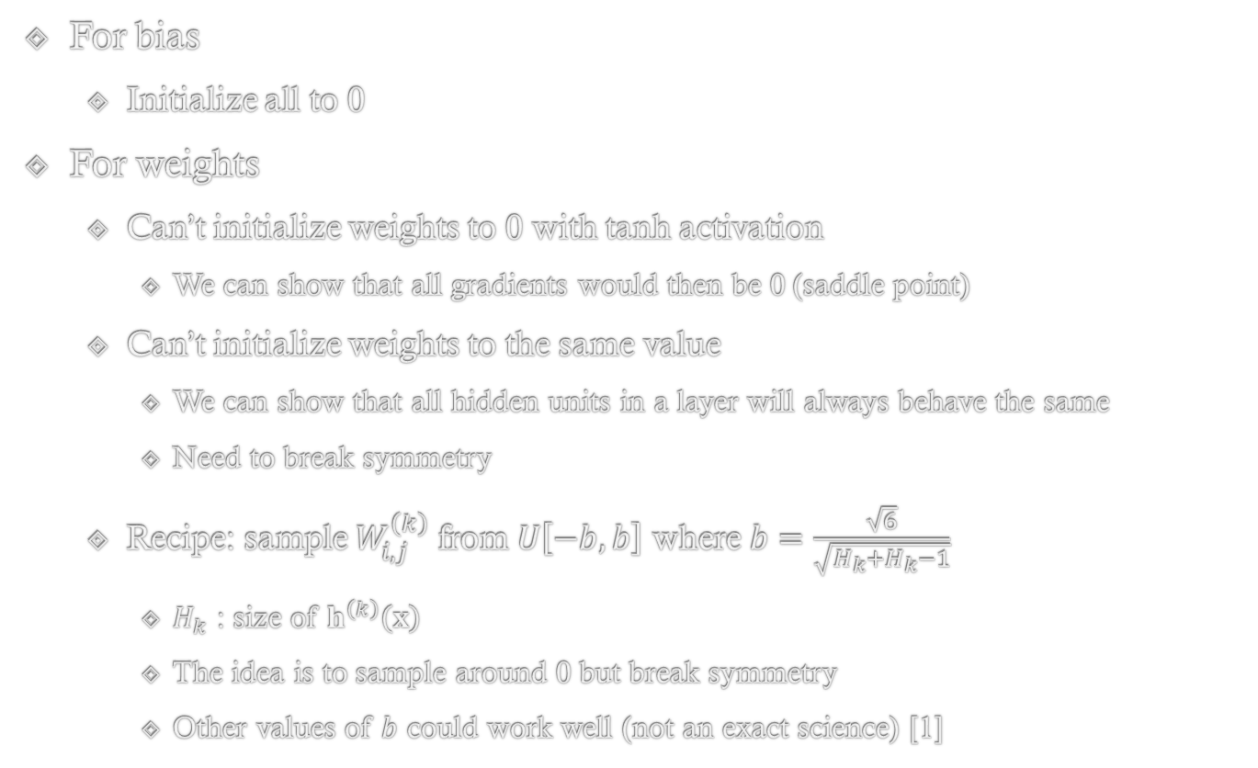
Weight Initialization
For bias
Initialize all to 0
For weights
Can’t initialize weights to 0 with tanh activation
We can show that all gradients would then be 0 (saddle point)
Can’t initialize weights to the same value
We can show that all hidden units in a layer will always behave the same
Need to break symmetry
Recipe: sample $W_{i,j}^{\left(k\right)}$ from $U\left[−b,b\right]$ where $b=\frac{\sqrt{6}}{\sqrt{H_{k}+H_{k}−1}}$
$H_{k}$ : size of $h^{\left(k\right)}\left(x\right)$
The idea is to sample around 0 but break symmetry
Other values of $b$ could work well (not an exact science) [1]
[1] Glorot, Xavier, and Yoshua Bengio. "Understanding the difficulty of training deep feedforward neural networks." International conference on artificial intelligence and statistics. 2010.

Slide 25
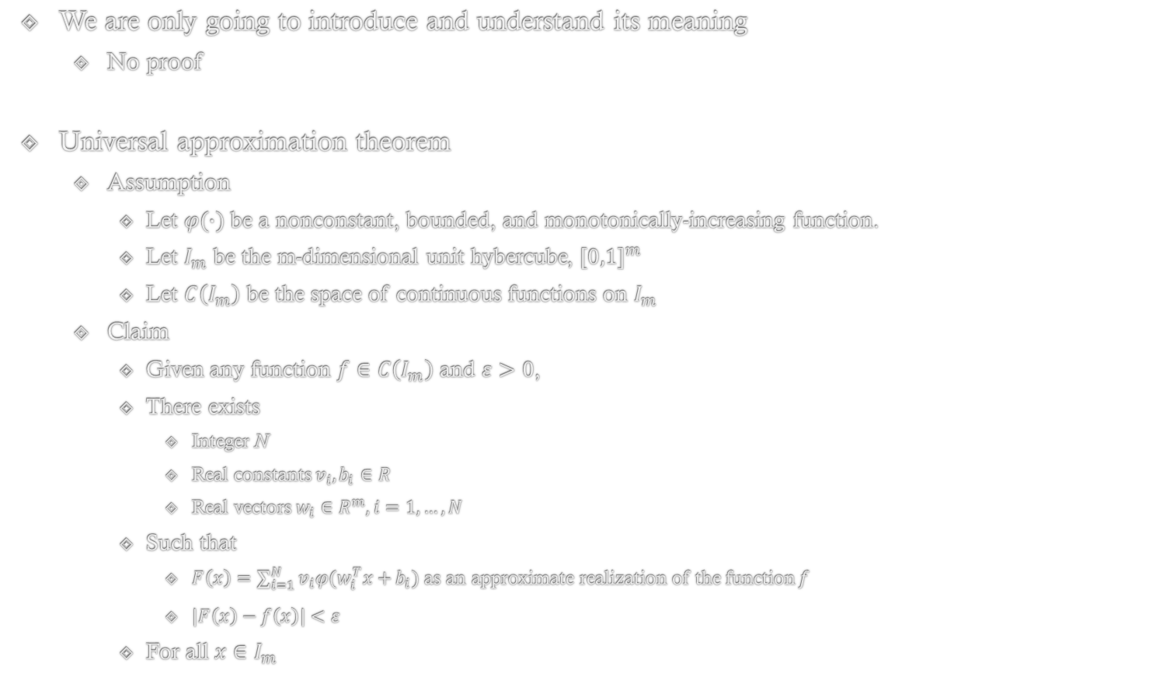
Universal Approximation Theorem
We are only going to introduce and understand its meaning
No proof
Universal approximation theorem
Assumption
Let $φ(∙)$ be a nonconstant, bounded, and monotonically-increasing function.
Let $I_{m}$ be the m-dimensional unit hybercube, ${[0,1]}^{m}$
Let $C\left(I_{m}\right)$ be the space of continuous functions on $I_{m}$
Claim
Given any function $f∈C\left(I_{m}\right)$ and $ε>0$,
There exists
Integer N
Real constants $v_{i},b_{i}∈R$
Real vectors $w_{i}∈R^{m}, i=1,…,N$
Such that
$F\left(x\right)=\sum_{i=1}^{N}{v_{i}φ(w_{i}^{T}x+}b_{i})$ as an approximate realization of the function $f$
$\left|F\left(x\right)−f\left(x\right)\right|<ε$
For all $x∈I_{m}$

Slide 26
Problem of Artificial Neural Network
Problem of gradient method
Vanilla version of gradient method
Random initialization? → Potentially very long learning process
→ Risk of local optima and saddle points
Problem of back-propagation
What-if many layers?
Multiplication of many gradients → Getting close to zero
Computation time
A single logistic regression → Multiple logistic regression with interactions
Long training time
Problem of structure
Is feasible and meaningful to fully connect the neurons?
LeCun, Yann, Yoshua Bengio, and Geoffrey Hinton. "Deep learning." Nature 521.7553 (2015): 436-444.

